Slide 1
Preliminary Investigation of Field-Aligned Electrons in the Magnetosphere
C. Schiff – 2/17/16 v0.1

Slide 2
Status
Performed a preliminary scan through v1.1 Fast Survey Quicklook Plots
Oct. 1st – Dec 1st
Looked for field-aligned structures in the medium energy band that occurs in the magnetosphere (or perhaps not in the magnetosheath)
Noted candidate dates and ‘drilled down’
Oct 4 10:00-18:00
Oct 5 – 14:00-18:00
Nov 4 – 02:00-04:00; 06:00-08:00
Nov 12 – 02:00-04:00

Slide 3
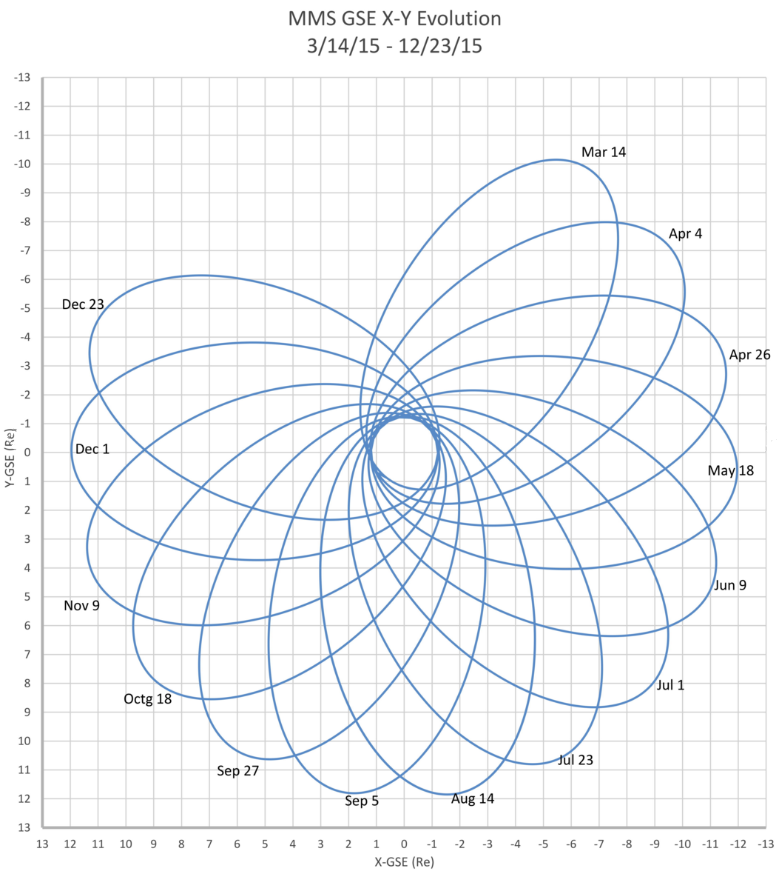
Orbit Geometry and Approximate Candidate Location
11/12
11/4
10/4-5

Slide 4
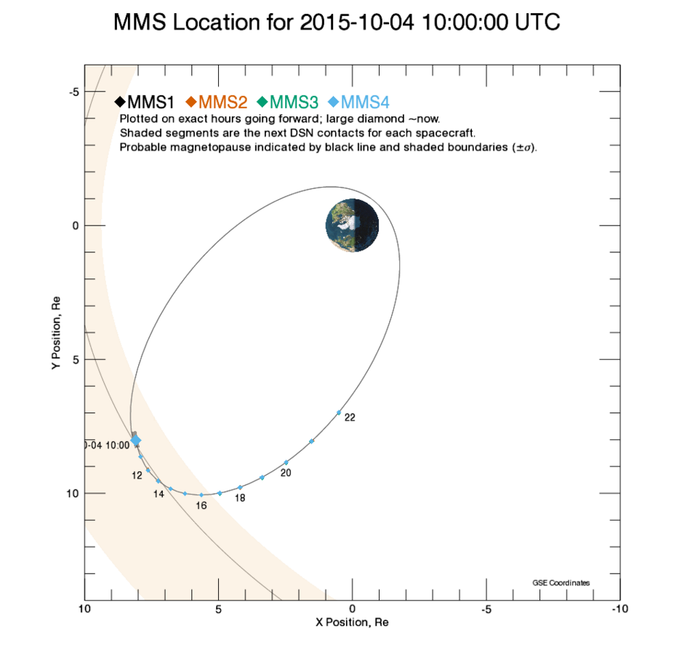

Slide 5
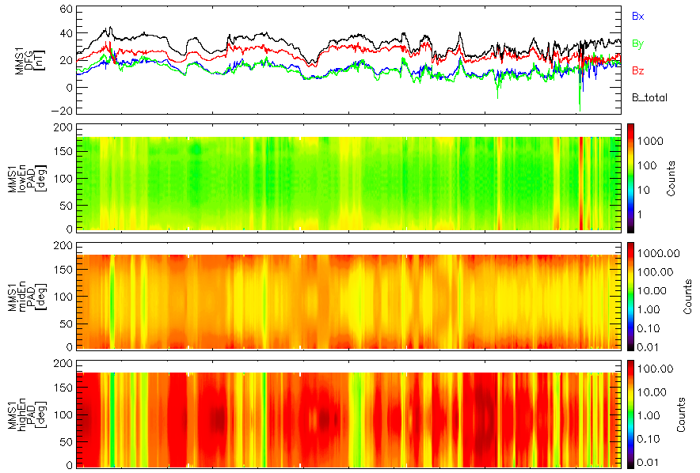
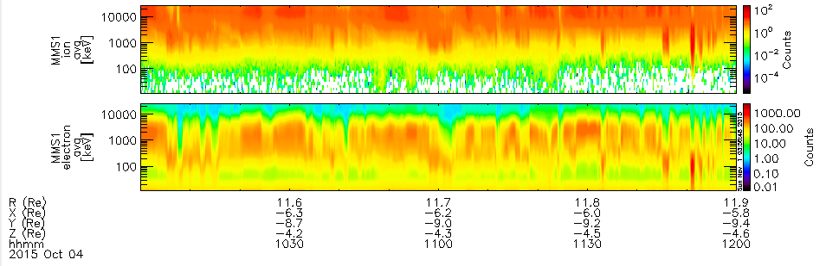




Oct. 4 – 10:00-12:00
$$\vec{B}$$
$$E_{low}:10…200 eV$$
Pitch Angle Dist.
$$E_{med}:200…2000 eV$$
$$E_{hi}:2…30 KeV$$
E-t spectrogram (ions)
E-t spectrogram (electrons)

Slide 6
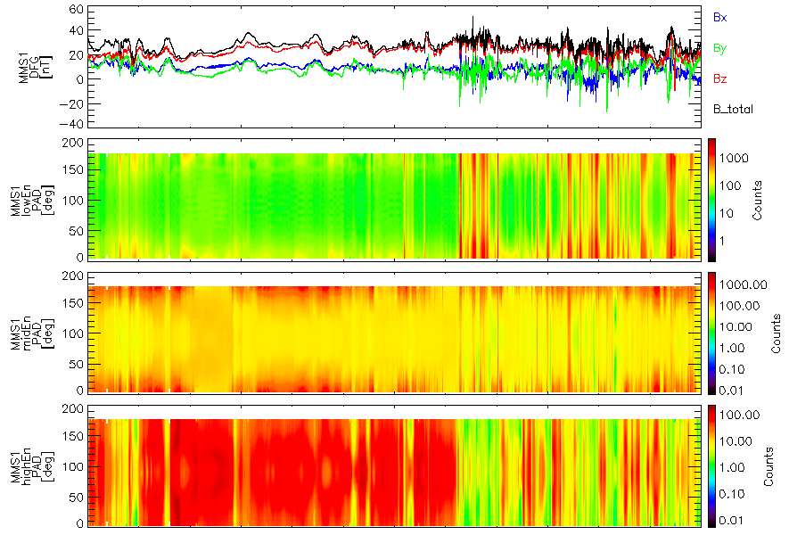
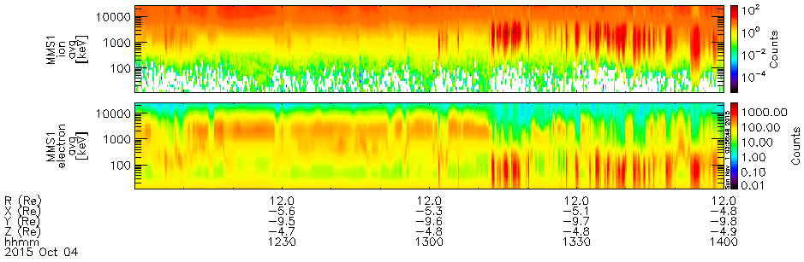
Oct. 4 – 12:00-14:00
$$\vec{B}$$
$$E_{low}:10…200 eV$$
Pitch Angle Dist.
$$E_{med}:200…2000 eV$$
$$E_{hi}:2…30 KeV$$
E-t spectrogram (ions)
E-t spectrogram (electrons)

Slide 7
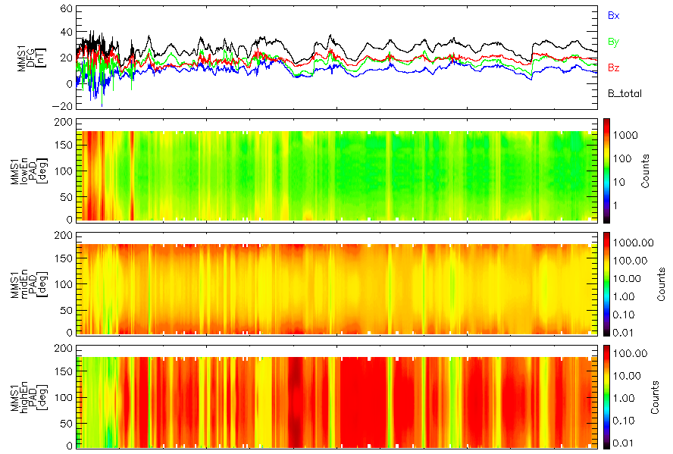
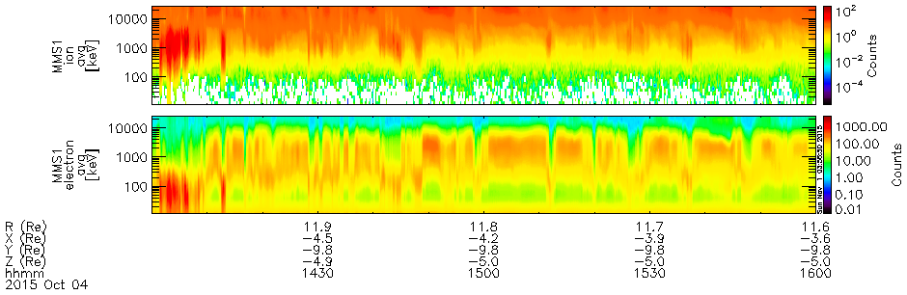
Oct. 4 – 14:00-16:00
$$\vec{B}$$
$$E_{low}:10…200 eV$$
Pitch Angle Dist.
$$E_{med}:200…2000 eV$$
$$E_{hi}:2…30 KeV$$
E-t spectrogram (ions)
E-t spectrogram (electrons)

Slide 8
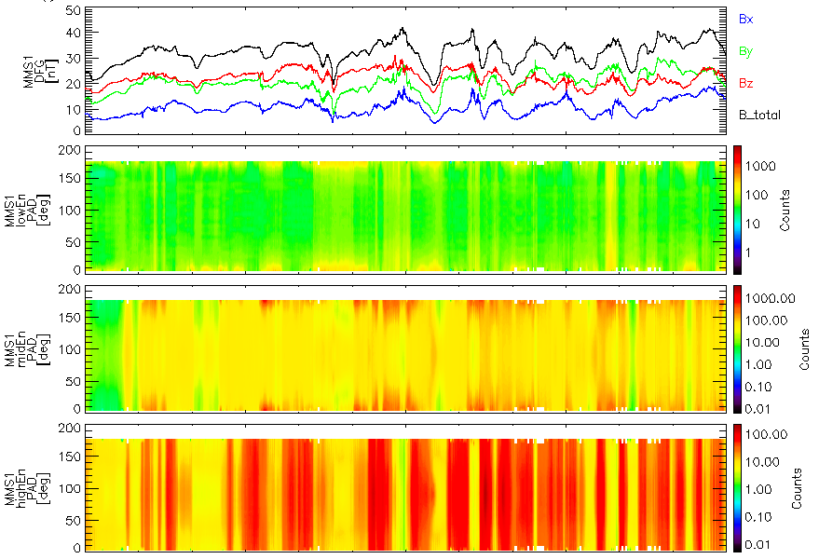
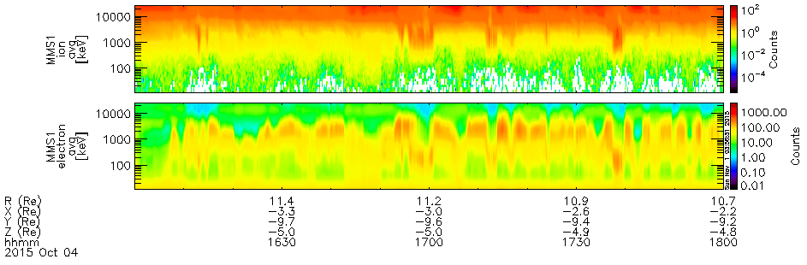
Oct. 4 – 16:00-18:00
$$\vec{B}$$
$$E_{low}:10…200 eV$$
Pitch Angle Dist.
$$E_{med}:200…2000 eV$$
$$E_{hi}:2…30 KeV$$
E-t spectrogram (ions)
E-t spectrogram (electrons)

Slide 9
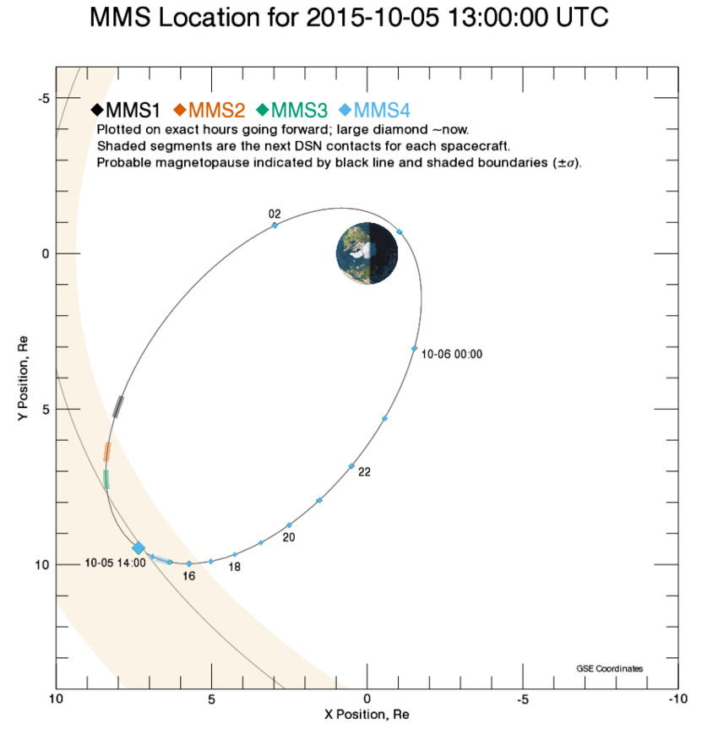

Slide 10
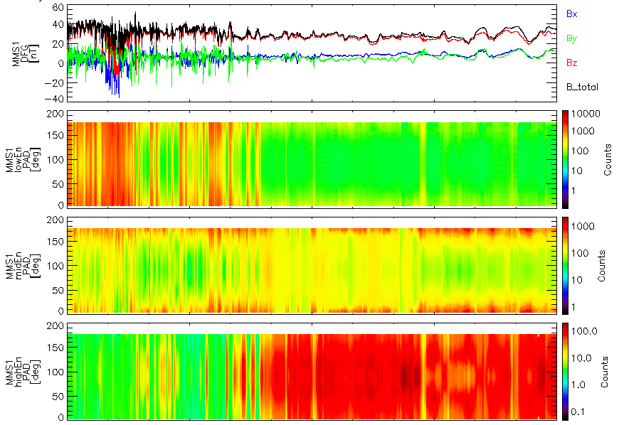
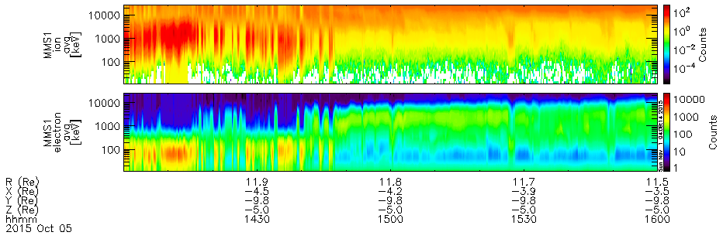
Oct. 5 – 14:00-16:00
$$\vec{B}$$
$$E_{low}:10…200 eV$$
Pitch Angle Dist.
$$E_{med}:200…2000 eV$$
$$E_{hi}:2…30 KeV$$
E-t spectrogram (ions)
E-t spectrogram (electrons)

Slide 11
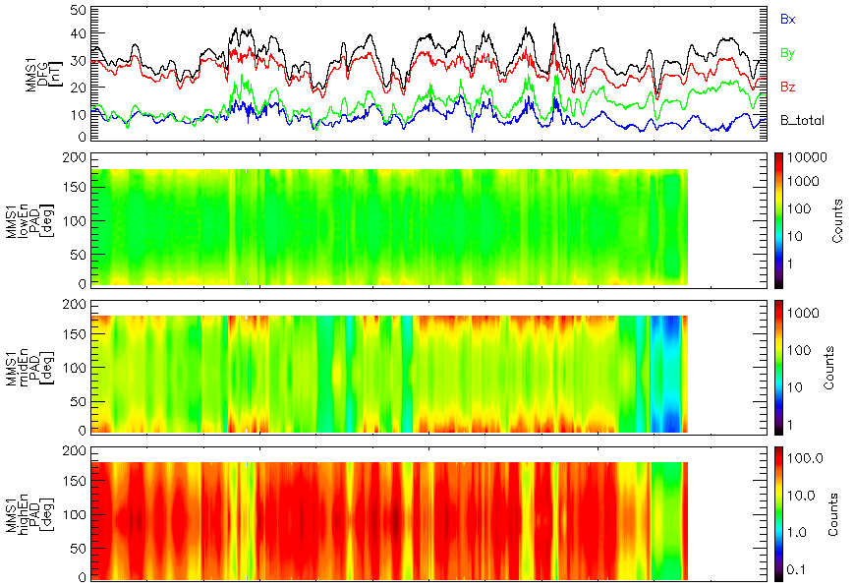
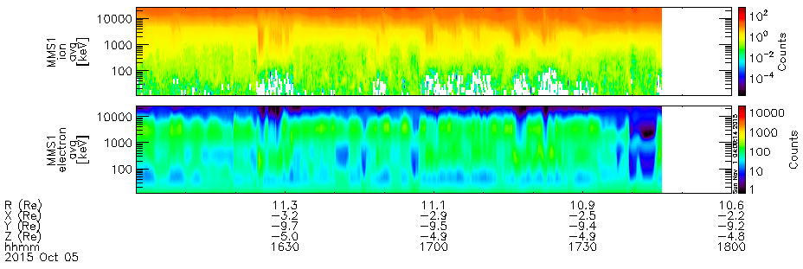
Oct. 5 – 16:00-18:00
$$\vec{B}$$
$$E_{low}:10…200 eV$$
Pitch Angle Dist.
$$E_{med}:200…2000 eV$$
$$E_{hi}:2…30 KeV$$
E-t spectrogram (ions)
E-t spectrogram (electrons)

Slide 12
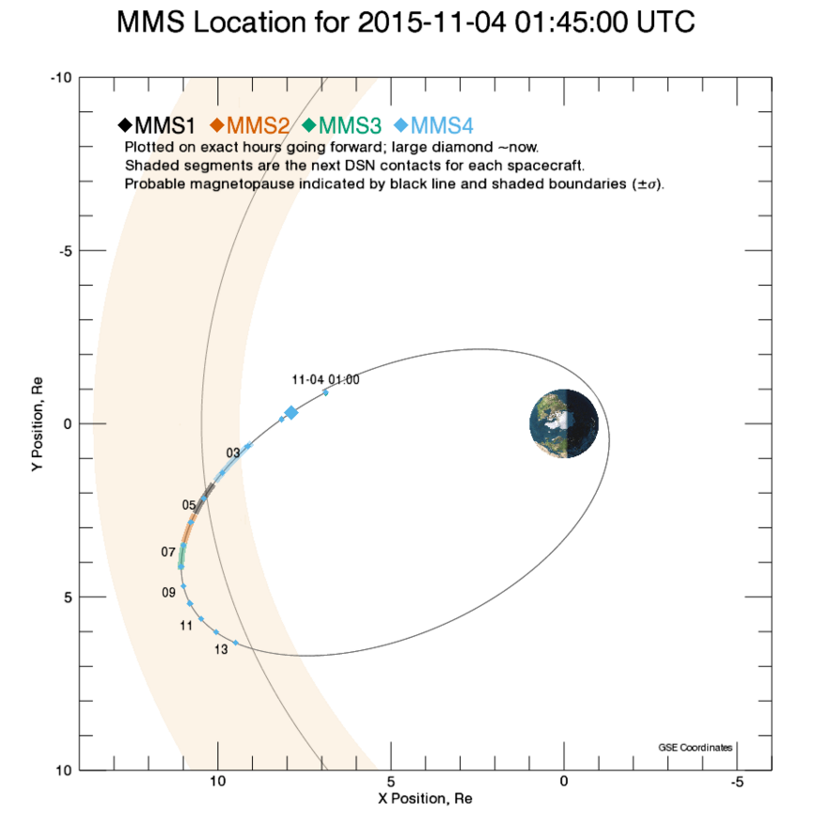

Slide 13
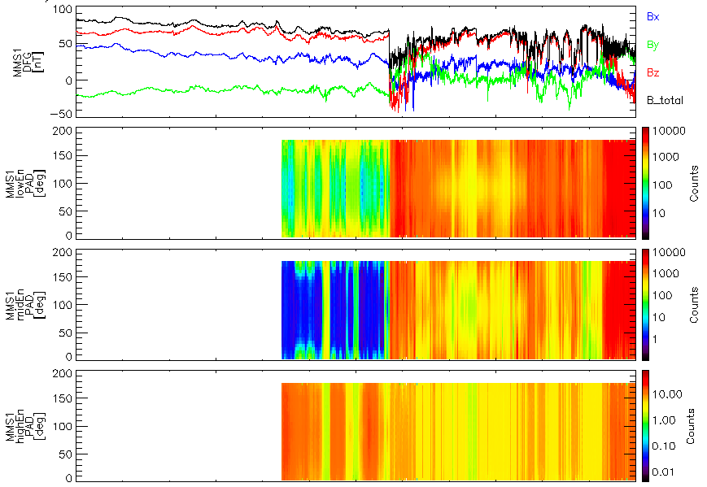
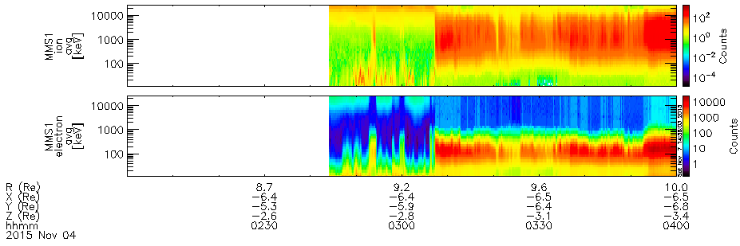
Nov 4 – 02:00-04:00
$$\vec{B}$$
$$E_{low}:10…200 eV$$
Pitch Angle Dist.
$$E_{med}:200…2000 eV$$
$$E_{hi}:2…30 KeV$$
E-t spectrogram (ions)
E-t spectrogram (electrons)

Slide 14
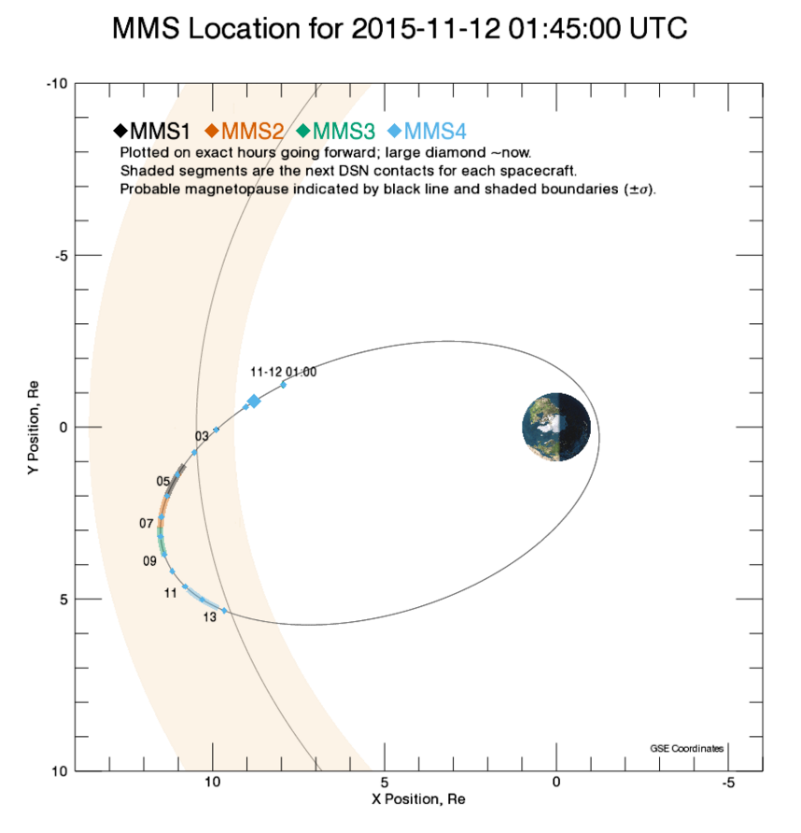

Slide 15
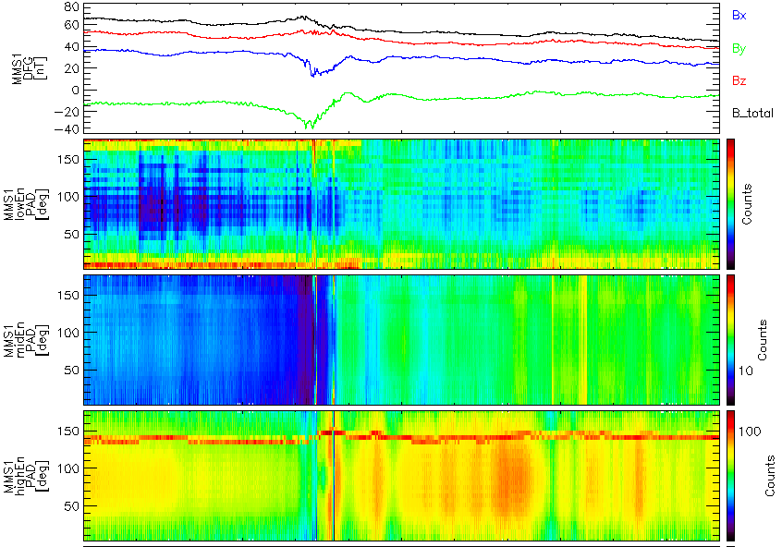
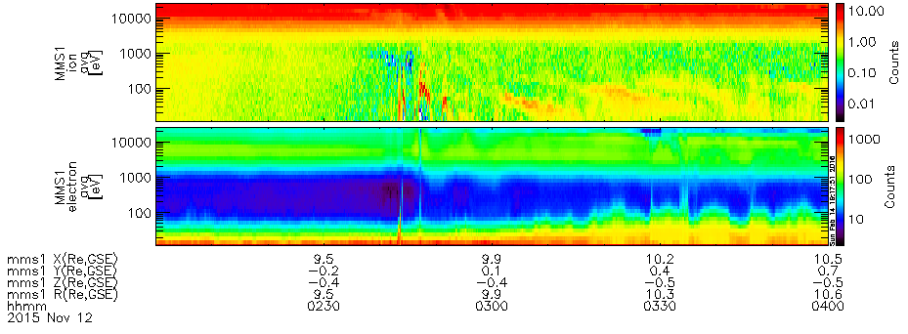
Nov 12 – 02:00-04:00
Caution: low count rates
$$\vec{B}$$
$$E_{low}:10…200 eV$$
Pitch Angle Dist.
$$E_{med}:200…2000 eV$$
$$E_{hi}:2…30 KeV$$
E-t spectrogram (ions)
E-t spectrogram (electrons)

Slide 16
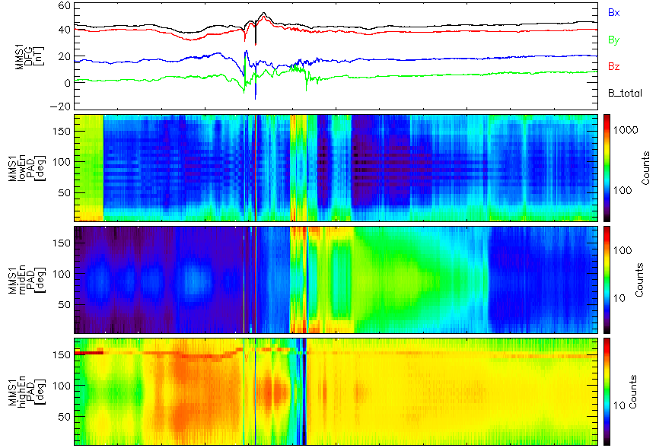
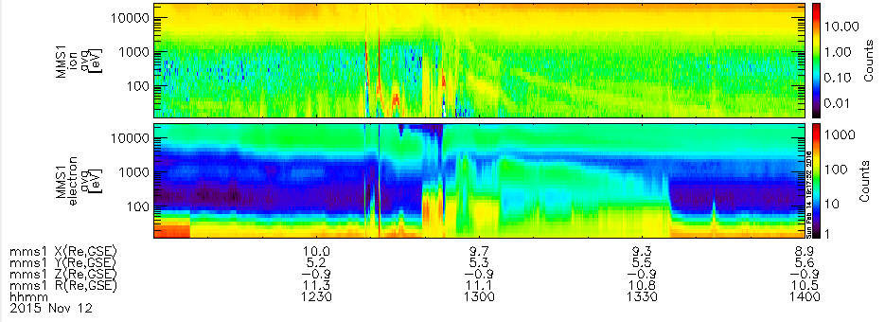
Nov 12 – 12:00-14:00
$$\vec{B}$$
$$E_{low}:10…200 eV$$
Pitch Angle Dist.
$$E_{med}:200…2000 eV$$
$$E_{hi}:2…30 KeV$$
E-t spectrogram (ions)
E-t spectrogram (electrons)

